Slide 1
HISTOGRAM EQUALIZATION
A DE2-115 SOLUTION FOR:
Aaron Volpone
CPE 409 - 1001
5/4/2017

Slide 2
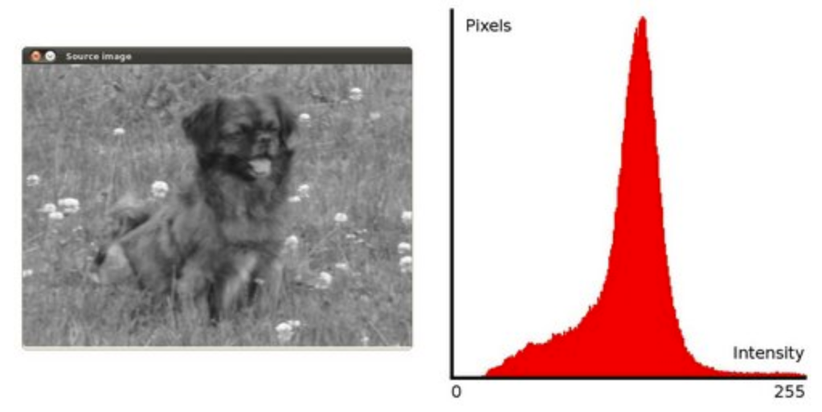
OVERVIEW
A image enhancement technique used to increase the overall contrast of an image with pixel data acquired through a histogram data.

Slide 3
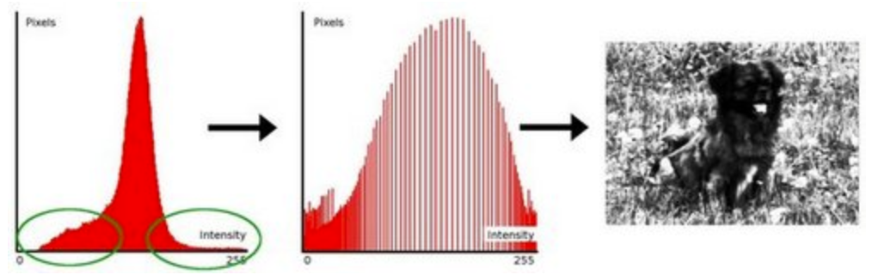
OVERVIEW cont.

Slide 4
PROCEDURE
FOUR STEP PROCESS
Collect pixel intensities – histOld[x, y]
Count the frequency of each element in the initial histogram, increment a 2D array corresponding to the pixel intensity found – pixelFreq[x, y]
Known as the: Cumulative equalization function
Calculate the new histogram distribution by pulling from the CDF. – histNew[x, y]
Push new pixel value to VGA controller, overwriting old image values

Slide 5


STEP ONE

Slide 6
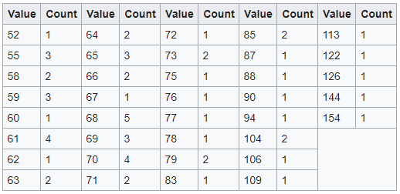
STEP TWO

Slide 7
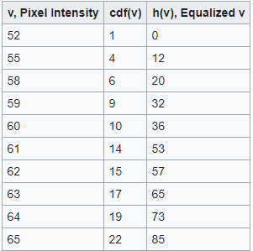
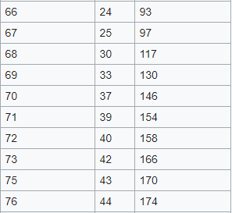
STEP THREE

Slide 8


STEP THREE cont.

Slide 9

STEP FOUR

Slide 10
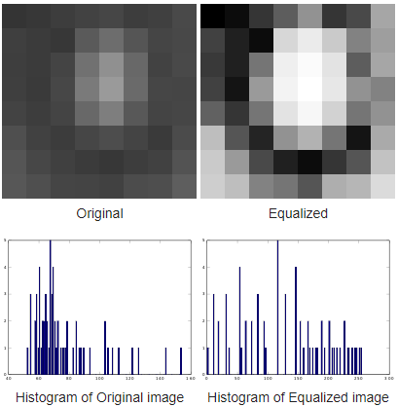
STEP FOUR

Slide 11
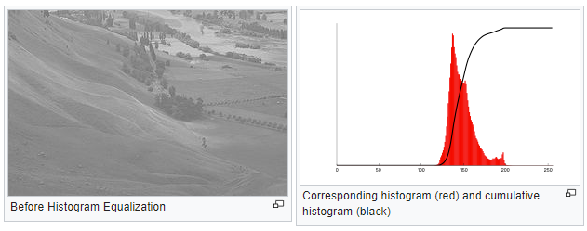

Slide 12
